Slide 1


CAMPUS
COMPASS
PROJECT
MIDTERM EVALUTION PERSENTATION

Slide 2

TABLE OF
CONTENTS
Git Workflows
NextJS
Frontend
User
Admin
Storybook
Backend
Progressive Web App
RabbitMQ
NGINX

Slide 3
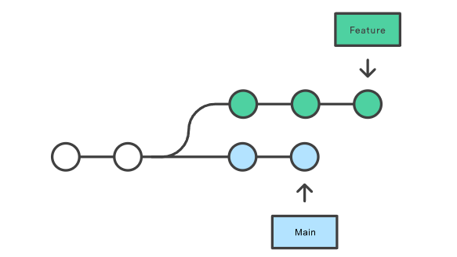
Git Merge v/s Rebase
Both git merge and rebase are used to integrate changes from one branch into another but they do it differently.
Consider you have a feature branch in which you are working, and the main branch gets updated with new commits. Suppose you want to incorporate the new changes into your feature branch, you will either use git merge or git rebase

Slide 4
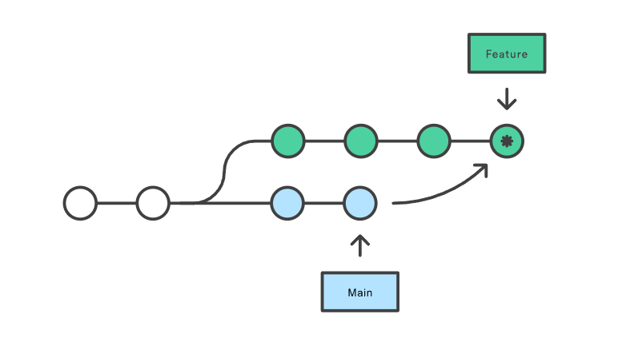
Git Merge
If you use git merge to incorporate the changes into your feature branch, it creates a new merge commit, which ties the histories/commits of both the branches.
Merging is a ‘non-destructive’ option as the existing branches are not altered in any way as opposed to git rebase.
Merging creates a non linear history for your branch as the merge commit points to two parent commits.
How to merge:
git checkout feature
git merge main

Slide 5
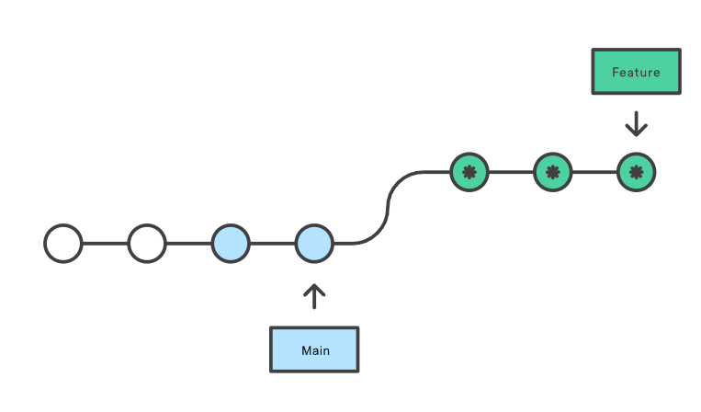
Git Rebase
When you do git rebase, it takes your feature branch and puts it on top of your main branch.
This rewrites the project history and creates a new commit for every commit in your feature branch. It effectively is as if you created your feature branch on top of the updated main branch.
Rebasing keeps a linear history for your branch making it easier to track commits.
How to rebase:
git checkout feature
git rebase main
GOLDEN RULE:
Never rebase in a public branch, as rebasing
changes the commit history, it can cause errors if other people pull after rebase as the git history in their local and the remote is changed

Slide 6
Git Merge and Rebase
When to use each
GIT MERGE
When the branch is public and multiple developers are working on it, as rebasing can cause inconsistent repositories among developers. Merge also keeps the history allowing you to see when changes from other branches were incorporated
GIT REBASE
When you are working alone on the branch, as it keeps the commit history linear and also interactive rebasing can be used before creating a PR to show a cleaner commit history in the PR.

Slide 7

Forking Workflow
Instead of using a single server-side repository to act as the “central” codebase, it gives every developer their own server-side repository. Each contributor has not one, but two Git repositories: a private local one and a public server-side one.
When contributers are ready to publish a local commit, they push the commit to their own public repository—not the official one. Then, they file a pull request with the main repository, which lets the project maintainer know that an update is ready to be integrated. The pull request also serves as a convenient discussion thread if there are issues with the contributed code.

Slide 8
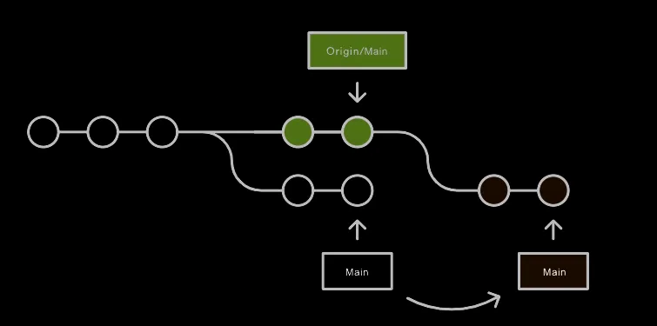

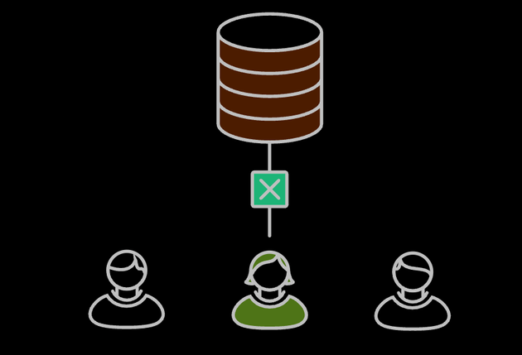
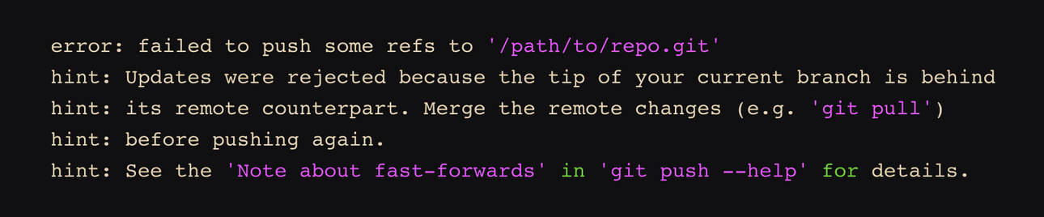
Centralized Workflow
Courier Prime
Courier Prime

Slide 9
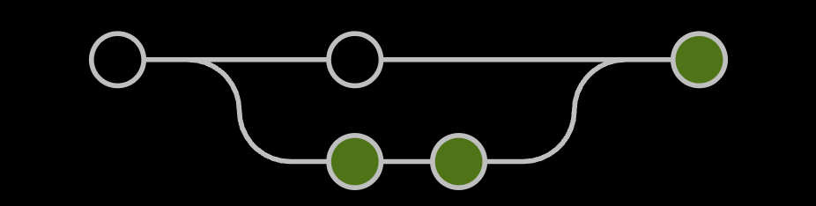
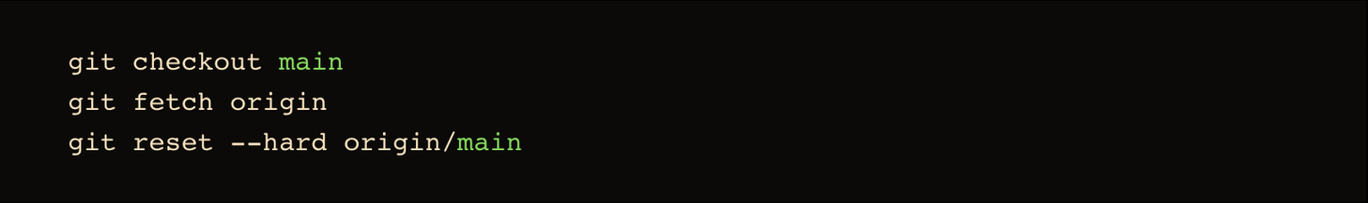

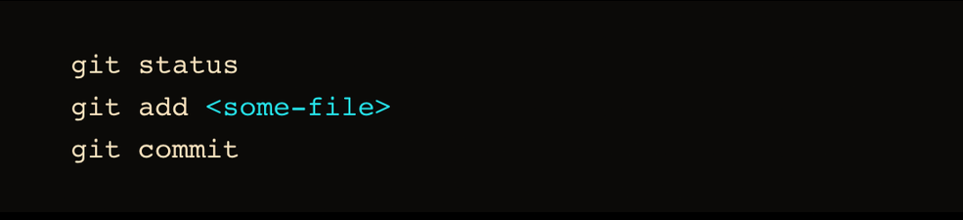

Feature Branch Workflow
The core idea behind the Feature Branch Workflow is that all feature development should take place in a dedicated branch instead of the main branch.
Courier Prime
Courier Prime
Encapsulating feature development also makes it possible to leverage pull requests, which are a way to initiate discussions around a branch. They give other developers the opportunity to sign off on a feature before it gets integrated into the official project.

Slide 10
Next JS
Next.js is a React framework for building full-stack web applications. You use React Components to build user interfaces, and Next.js for additional features and optimizations. It also automatically configures lower-level tools like bundlers and compilers.
NEXT.JS HAS TWO DIFFERENT ROUTERS:
App Router: The newer router that supports new React features like Server Components
Pages Router: The original router, still supported and being improved.server side components are not natively featured
Features of using NextJS:
URL Managment with simple folder structure
Server side components automatic support (with app router)
Image optimization
supports dynamic routing/grouping of different webpages
API Routes (we can create Backend API directly in nextjs without requring seperate backend API)
DEFINITIONS:
ROUTER: A ROUTER IS A SYSTEM (OFTEN A LIBRARY OR BUILT-IN FRAMEWORK FEATURE) THAT MANAGES NAVIGATION BETWEEN DIFFERENT VIEWS OR PAGES IN A WEB APPLICATION WHILE KEEPING THE UI IN SYNC WITH THE URL.
FRAMEWORK:A FRAMEWORK IS A PRE-BUILT, OPINIONATED STRUCTURE THAT PROVIDES REUSABLE COMPONENTS, TOOLS, AND PATTERNS TO STREAMLINE APPLICATION DEVELOPMENT IN A SPECIFIC LANGUAGE OR ECOSYSTEM.

Slide 11
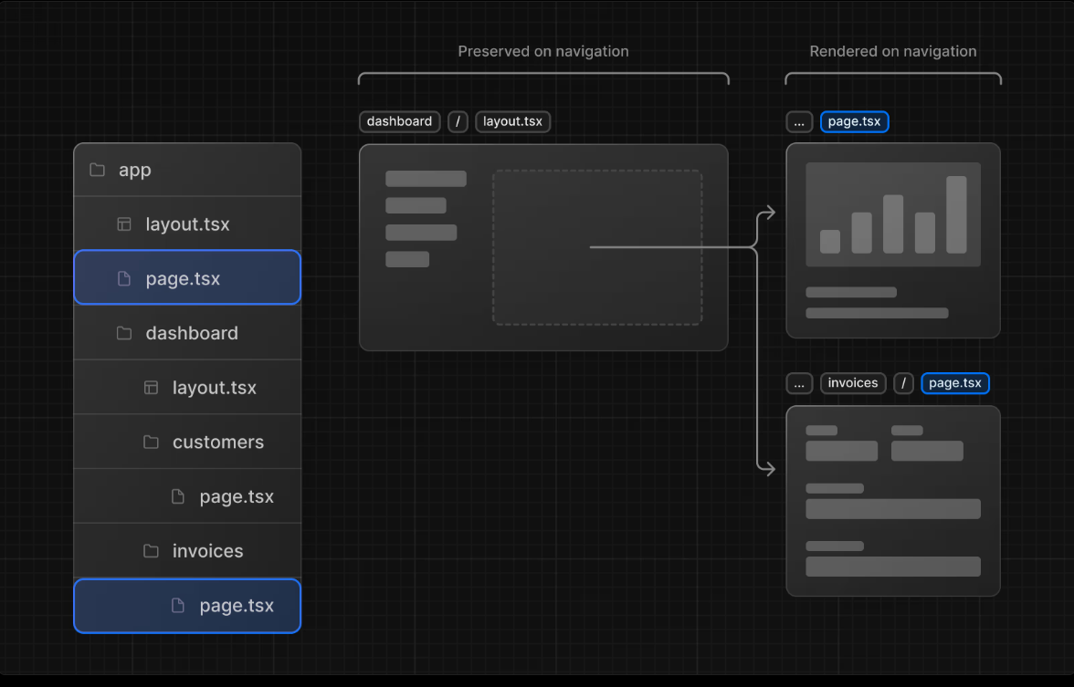
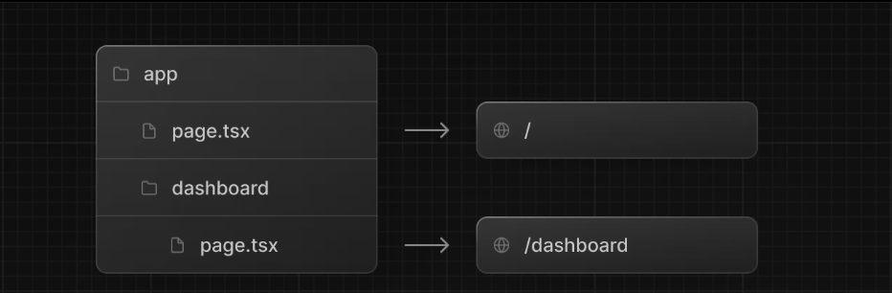
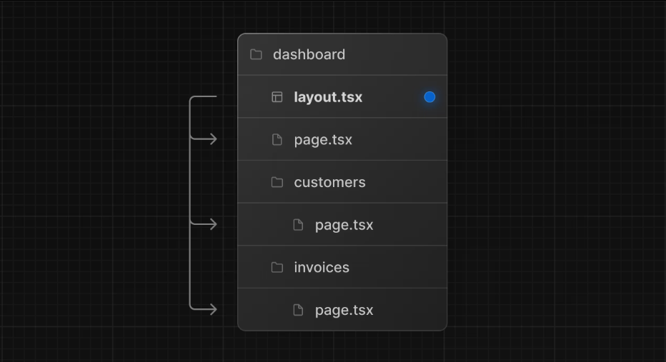
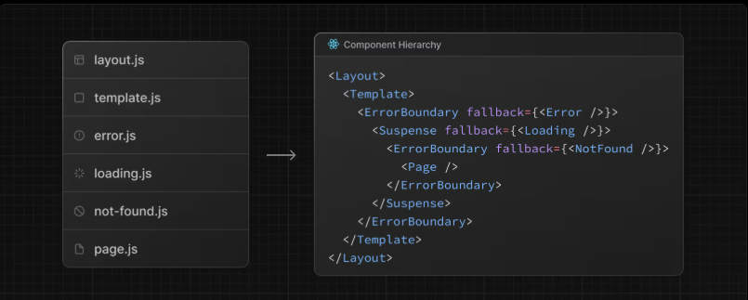

Slide 12
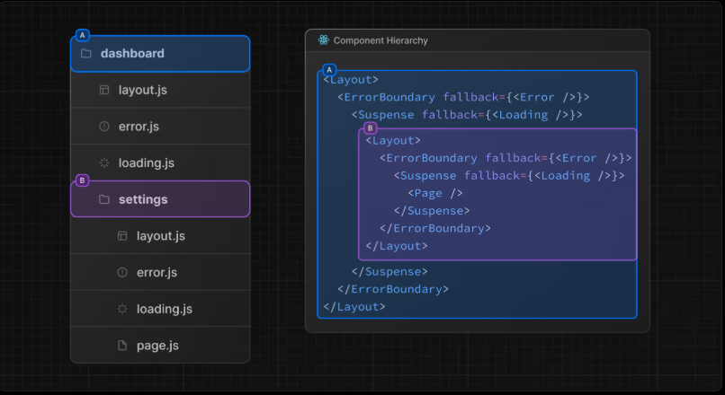
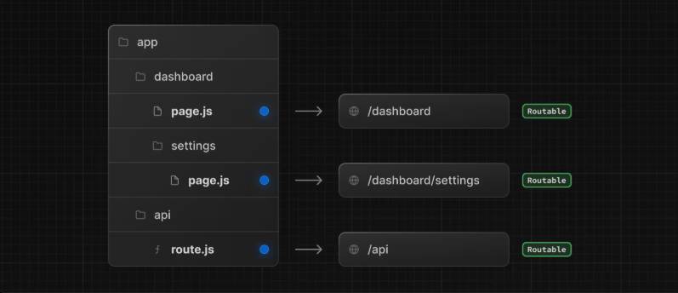
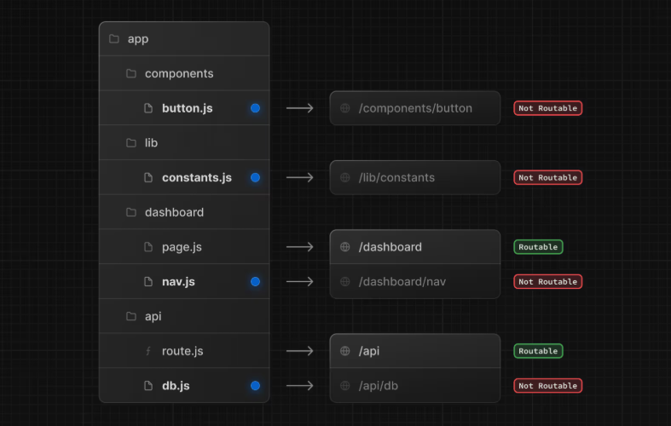
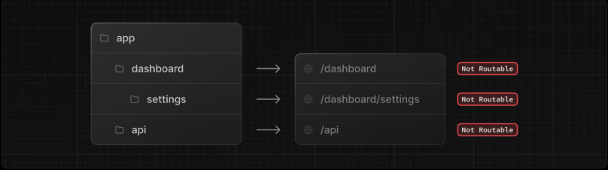

Slide 13
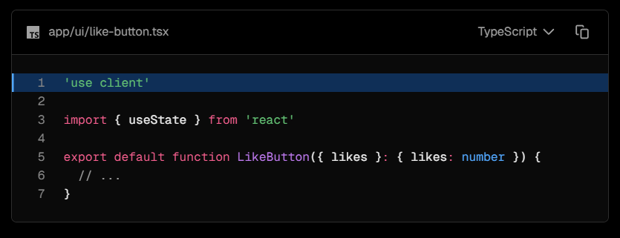
Components that NextJS features
SERVER SIDE
RENDERED ON THE SERVER WHEN A CLIENT DEMANDS AND SENT TO THE CLIENT.BY DEFAULT NEXT JS APP ROUTER SUPPORTS THIS TYPE OF RENDERING
CLIENT SIDE
THE JAVASCRIPT ASSOCIATED WITH THE CREATION OF THAT COMPONENT IS SENT TO THE CLIENT/BROWSER AND THE CLIENT CREATES THAT ELEMENT FORM THAT JAVASCRIPT.THESE ARE INTERACTIVE PART OF THE WEBSITE.
WE CAN ALSO CREATE THESE WITH NEXTJS

Slide 14
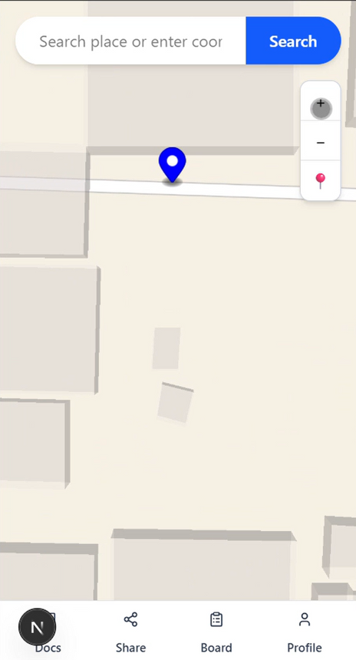
Frontend UI
We are designing the frontend UI for two sites/application and that is one for the User side and the other for the Admin side. Let’s talk about it one by one:
User Side UI:
This UI has been decided to be mobile centric due to mobile portability and availability. So the mobile screen will show a homepage containing a search bar along with a map in the background and certain navigation options in the lower bottom corner of the home page.
Search Bar: Using MapLibre the search bar can search for any place by typing its name or the latitude and longitude of that place, which pin points the location if search results match.
Navigation Bar: The bottom of the page has 4 options for navigation which are discussed in the upcoming slides.

Slide 15
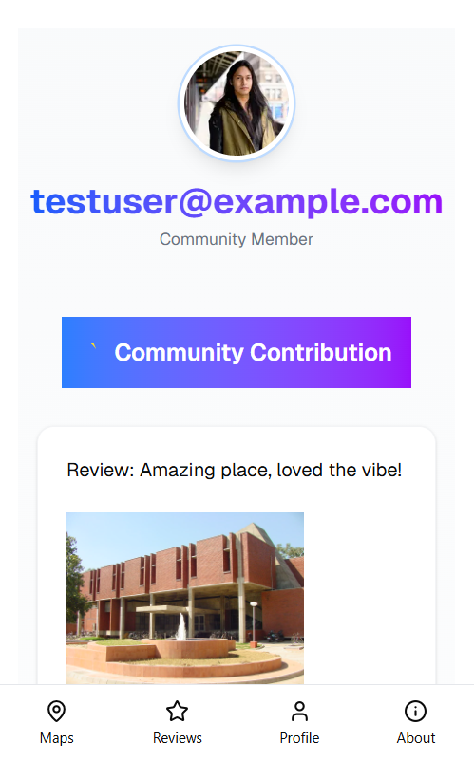
Navigation Options:
Profile Section:
Here one can Sign In with his/her ID and password and Log In if already made.
If the user already is logged in then it will show another pop up UI which tells about the user’s ID and email for verification otherwise the user is redirected to another UI where he is asked about his/her personal info and email ID for verification and a recent activity page is shown. After filling up the info, user will be ready to back and login with his ID.

Slide 16
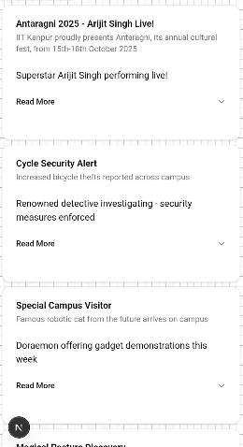
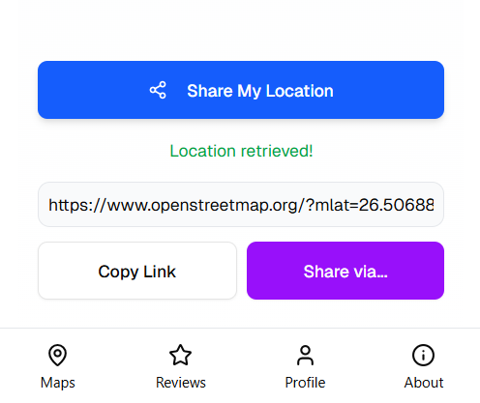
Noticeboard Section:
Just like a school noticeboard this section will contain necessary information to be published publicly like all the events going on in the campus and where. The UI contains various tiles which user can copy or share as a piece of information on various platforms.
Share Location:
This is a very useful feature for the newcomers and others too as you can share your exact location in IIT Campus allowing you to find nearest path to a certain location efficiently.

Slide 17

Official Docs Section:
This redirects the user to the official docs webpage of the Campus Compass where one can find the official Docs of it.
Add Review Feature:
This is a feature for rating and adding a personal review in the community letting others know about it. People can rate among 5 stars add pictures of the location or write their thoughts about it and when clicking on a location, it opens the location details along with an add review option which shows this UI which is a menu that slides up for adding the review.

Slide 18
Admin Side UI:
The admin UI will is catered for desktop use and will provide various administrative functionalities as followed:
Active Sessions
Active Sessions
Active Sessions
Nav Bar
Logs
1.5 K
1.5 K
1.5 K
Configure
Graph
Configure
Graph
Configure
Graph
The side navigation bar in the diagram serves as the primary menu for navigating between different sections or modules of the portal.
Requests
Id
Description
Action 1
Action 2
Noticeboard
Flags
Table Component
We made a generic table component that can be used for all types of entries in Logs, Requests and Flags.
Logout

Slide 19
At the top of the sidebar, there are four clearly labeled buttons:
Logs: Takes the user to the panel that shows various updates and logs.
Requests: Leads to a section where user requests(for adding a new location) are listed and managed.
Noticeboard: Shows announcements, update and alerts.
Flags: Lists reviews or images that have been flagged for attention or review.
Logs
Requests
Noticeboard
Flags
At the bottom of the side bar, the Log Out button enables the admin to log out of the page.
Indicator Component : It is a generic indicator component that enables the user to access specific list data, or progress bar. eg- active sessions , total users, not reviewed requests or flags.

Slide 20

TORYBOOK
What is Storybook?
Storybook is a tool that lets us build, test, and showcase UI components in isolation, outside of the main application. This makes it easier to develop components independently.
Why use Storybook?
Storybook lets us build and test parts of the UI independently without needing the full app to run. This makes it easier to catch and fix bugs early, try things out quickly, and test with dummy data even if the backend isn’t ready yet. Any changes made in the components show up instantly, which helps in visualizing, while also keeping things organized and consistent.

Slide 21
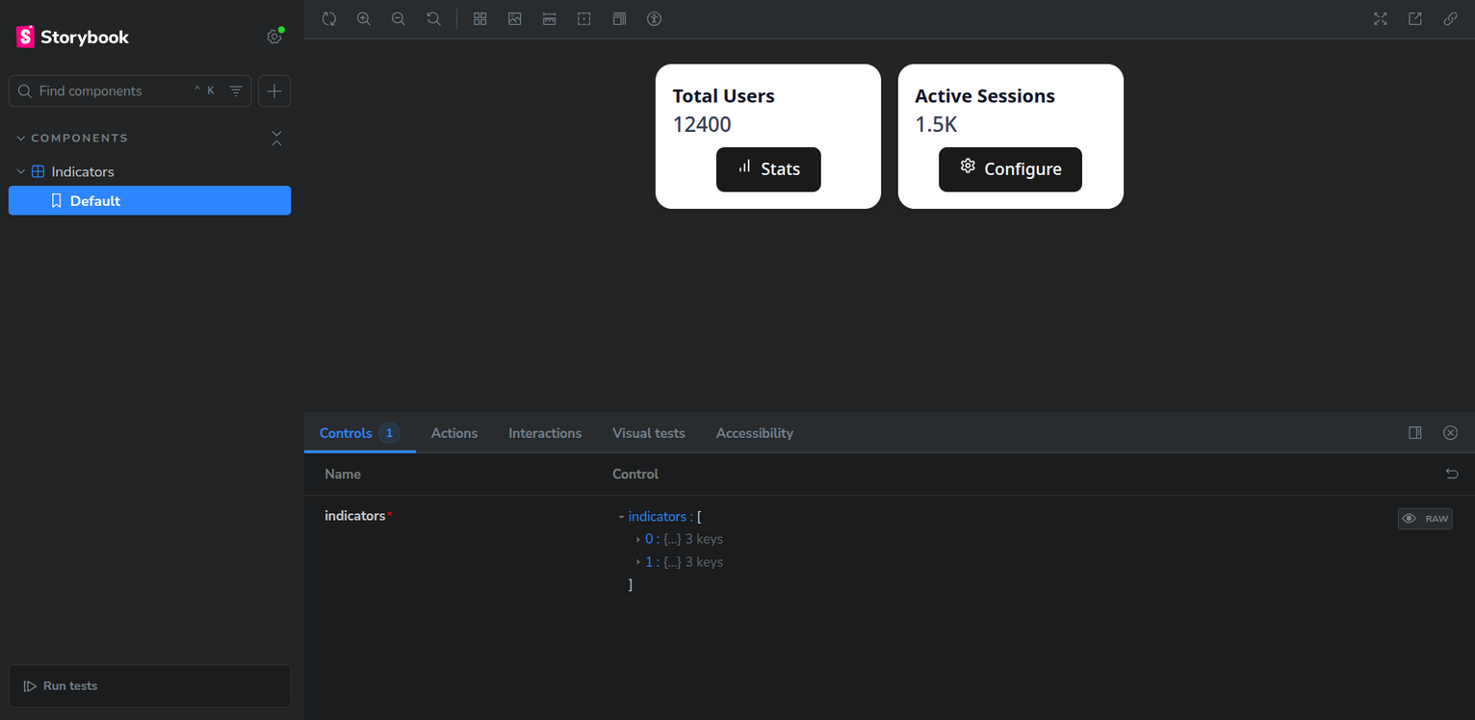
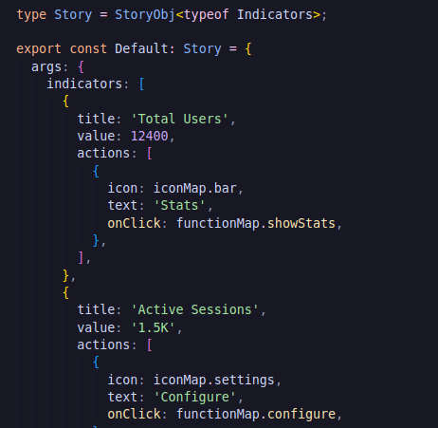
A basic Storybook implementation is displayed here.
On the left we have a snippet from the Storybook config of the Indicator Component. It shows the input values to the component. After importing the component, and running the Storybook instance, we see a landing page like below, which helps in visualizing the UI separately.

Slide 22


Backend
: HEART OF THE WEB
The UI comes to life only with the backend working behind the scenes. This is where we introduce Golang which is an efficient choice for backend due to its simplicity, performance, and scalability.
GOLANG
Web frameworks: Gin, Gorm
Concurrency Made Easy
Low Latency: Efficient garbage collection and goroutines (lightweight threads) reduce overhead, making it ideal for high-performance APIs and microservices.
Minimal Runtime: Unlike interpreted languages (Python, Ruby) or JVM-based languages (Java, Kotlin), Go has a small runtime footprint.

Slide 23
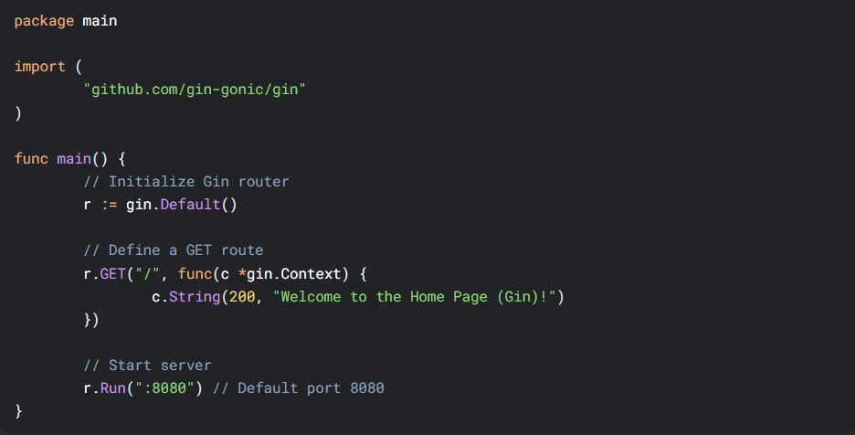
ROUTES IN GO
GIN.DEFAULT() creates a router with default middleware (logging, recovery)
R.GET("/", ...) defines a GET route at /
C.STRING(200, ...) sends a plain text response.
c *gin.Context is a central object that holds all the information about an HTTP request and provides methods to handle the response. It is passed to every route handler and middleware function.
Go's concurrency (goroutines and channels) enables high-performance, scalable backends by handling thousands of tasks simultaneously with minimal overhead, avoiding callback hell while simplifying parallel I/O and CPU-bound workloads. This makes it a good choice for handling APIs.

Slide 24

Progressive Web App
Progressive Web Apps (PWAs) are modern web applications that deliver a native app-like experience directly through the browser. They combine the best features of both web and mobile apps—offering speed, responsiveness, offline capabilities, and user engagement. PWAs are built using standard web technologies like HTML, CSS, and JavaScript, or frameworks such as React or Next.js. While they run in the browser, they can also be installed on devices, making them feel and function like traditional mobile apps.
Benefits
Cross-platform compatibility (works on iOS, Android, desktop).
Improved performance with caching and Service Workers.
Enhanced user engagement (push notifications, home screen icons).

Slide 25
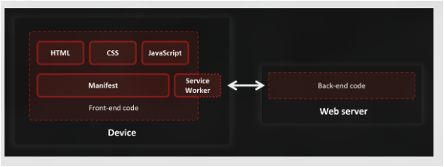
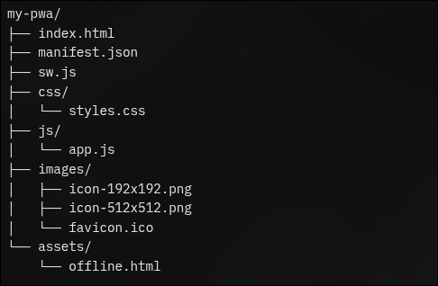
Technologies Behind PWAs
Service Workers: Enable offline functionality and caching for fast load times.
Web App Manifest: JSON file for installability, defining app name, icons, and display mode.
HTTPS: Ensures secure communication, a requirement for PWAs.
Frameworks: Next.js
Building a PWA
Create a Responsive Web App: Ensure it works well on all screen sizes and devices.
Web App Manifest: A manifest.json file that defines the app’s name, icons, theme color, and how it should appear when installed.
Implement a Service Worker: A background script that handles offline caching, push notifications, and performance improvements.

Slide 26

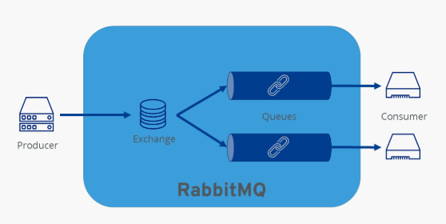
RabbitMQ
One broker to queue them all
RebbitMQ is a lightweight message queue system built on top of Redis, designed to help different parts
of an application communicate asynchronously. Think of it as a post office inside your app when the frontend triggers a task (like sending an email or processing an image), the backend puts that task into RedisMQ, and a background worker picks it up and completes it. This makes the app faster and more responsive since users don’t have to wait for heavy tasks to finish.
Using RebbitMQ makes your app really communicative and more organized by handling tasks in the background. It's perfect for things like sending notifications, scheduled messages. Without RebbitMQ, your backend tries to do everything at once like sending emails while also replying to users which slows things down. RedisMQ takes care of these tasks silently in the background, so your app stays smooth, fast, and user-friendly.

Slide 27
Key Features of RabbitMQ
Message Queuing
Stores messages safely in a queue until the consumer is ready to process them.
Durable & Reliable
Messages are saved to disk, so even after a server restart, they aren't lost.
Publisher/Consumer Model
One side sends (publisher), the other side receives and processes (consumer).
Multiple Queues
Messages can be sent to different queues, each handled by different workers or services.
Language Support
Works well with many programming languages like JavaScript, Python, Go, Java, etc.
How Queues Work in RabbitMQ (Behind the Scenes)
It is a server that runs either on your local machine or in the cloud. It listens for messages from
producers, like your backend application, and stores those messages in a queue. When a
consumer is ready, RabbitMQ delivers the message to it. The consumer then processes the task like sending an email and sends back an acknowledgment. If the consumer crashes or doesn’t respond, RabbitMQ either retries delivering the message or stores it safely for later, ensuring no message is lost.

Slide 28

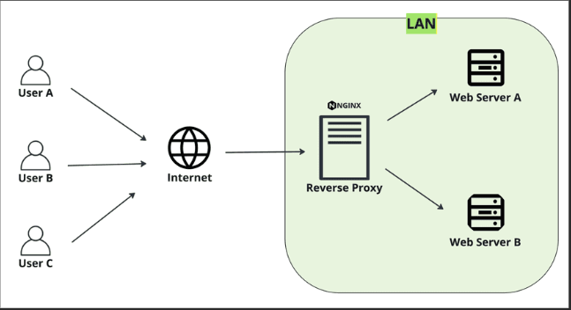
NGINX
NGINX is a high performance web server that also functions as a reverse proxy, load balancer, and HTTP cache. It’s designed to handle thousands of simultaneous connections with minimal resource usage. When users send requests to your website, NGINX efficiently routes them to the right backend service, making your application faster and more scalable.
Besides being fast, NGINX also helps keep your app safe. It manages secure connections (HTTPS), hides your backend servers, and filters incoming requests to block bad ones. It can also share traffic between servers, send files quickly, and store copies of responses to reduce extra work. That’s why many of the world’s top websites use NGINX it’s fast, smart, and doesn’t use much memory.

Slide 29

DEMOS

Slide 30
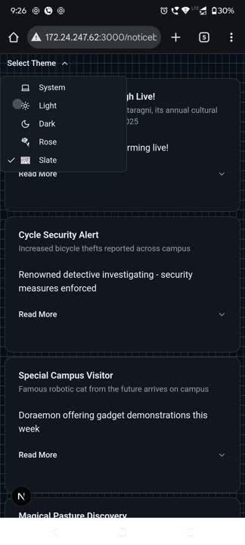
NOTICEBOARD

Slide 31
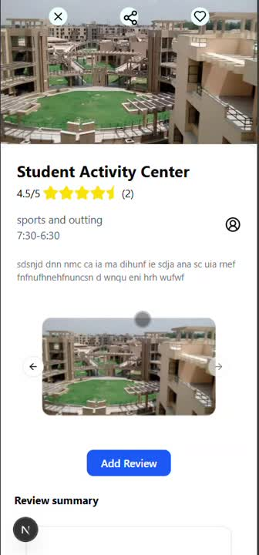
Location Page

Slide 32

PROFILE SECTION

Slide 33
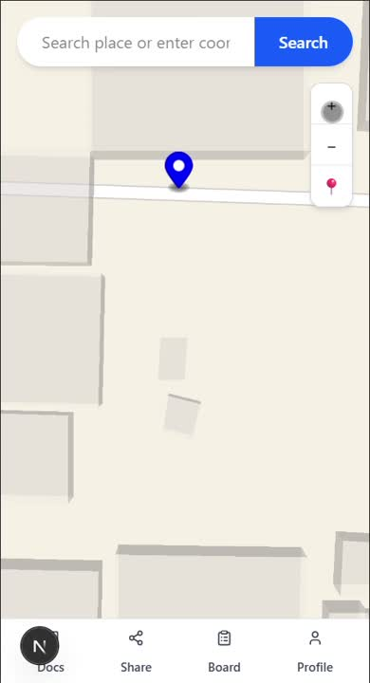
HOMEPAGE

Slide 34

THANK YOU

